Slide 1
HW6.2 Graphing Absolute Value Equations:

Slide 2

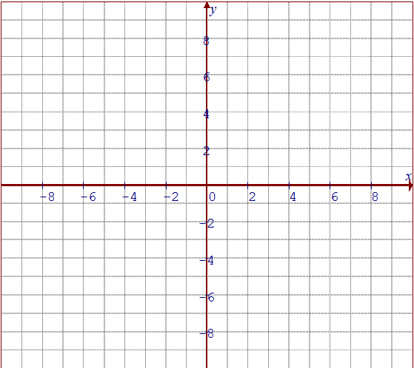
Graph each absolute value function. Find the x-intercept and then state the piece wise function

Slide 3

Graph each absolute value function. Find the x-intercept and then state the piece wise function

Slide 4

Graph each absolute value function. Find the x-intercept and then state the piece wise function

Slide 5

Graph each absolute value function. Find the x-intercept and then state the piece wise function

Slide 6

Graph each absolute value function. Find the x-intercept and then state the piece wise function

Slide 7

Graph each absolute value function. Find the x-intercept and then state the piece wise function

Slide 8

Graph each absolute value function. Find the x-intercept and then state the piece wise function

Slide 10


Slide 11

7. Solve each of the following equations

Slide 12

7. Solve each of the following equations

Slide 13

7. Solve each of the following equations

Slide 14

7. Solve each of the following equations

Slide 15

7. Solve each of the following equations

